Slide 1
Azure For Developers
Anthony Chu
Jeremy Likness
Brandon Minnick

Slide 2
Meet the Instructors

Slide 3

Anthony Chu
Cloud Dev Advocate @ Microsoft
Something interesting here
https://anthonychu.ca/
@nthonyChu
Anthony.Chu@microsoft.com

Slide 4
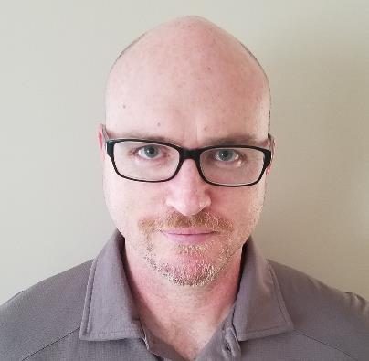
Jeremy Likness
Cloud Dev Advocate @ Microsoft
24+ Year Professional Dev
https://blog.jeremylikness.com/
@JeremyLikness
Jeremy.Likness@microsoft.com

Slide 5

Brandon Minnick
Cloud Dev Advocate @ Microsoft
Something interesting here
https://github.com/brminnick
@TheCodeTraveler
Brandon.Minnick@microsoft.com

Slide 6
Agenda
Introduction to Azure and the Cloud
Introduction to Azure Storage
Hosting apps in Azure
Serverless on the Azure platform
Security
Mobile
Conclusion

Slide 7
While we’re presenting …
You will need an Azure account
Please confirm you can access your account
If you need and account, visit: <link>
Reach out if you are having problems!

Slide 8
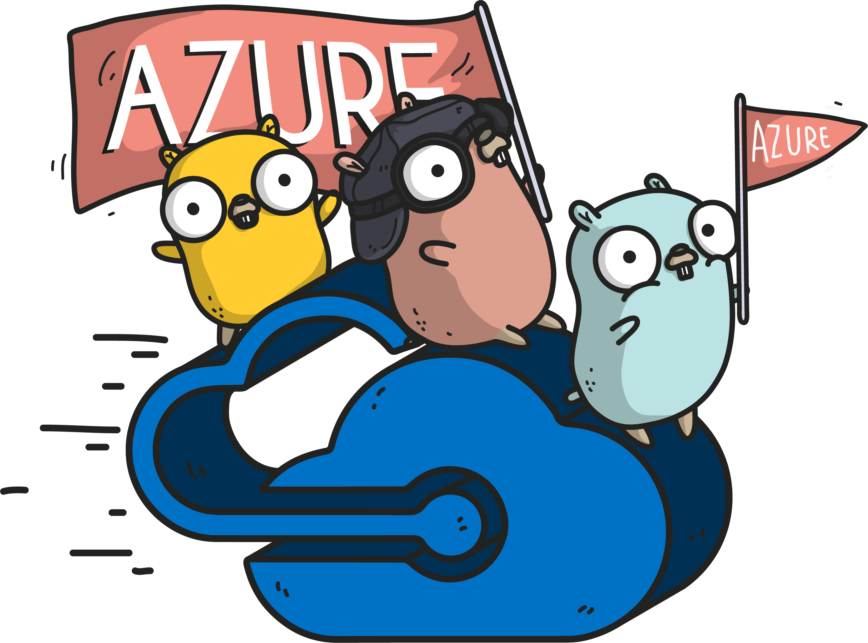
What is the Cloud?

Slide 9
What is the right size of
servers for my business needs?
How do I deploy new code to my server?
What media should I
use to keep backup?
What happens in case of
server hardware failure?
Which packages should be on my server?
What size of servers
should I buy?
Who monitors
my App?
How often should I backup my server?
How can I scale my app?
How can I increase server utilization?
Who has physical
access to my servers?
Which OS should I use?
Do I need secondary network connection?
Are my server in a
secure location?
What happens if the
power goes out?
Who monitors
my Servers?
Do I need a UPS?
What storage I need to use?
How many servers
do I need?
How can I dynamically configure my app?
It takes how long to provision a new server?
How often should
I patch my servers?
On-Premises
@JeremyLikness
The “evolution” of application platforms

Slide 10
What is the right size of servers for my business needs?
How can I increase server utilization?
How many servers do I need?
How can I scale my app?
How often should I patch my servers?
How do I deploy new code to my server?
How often should I backup my server?
Which OS should I use?
Which packages should be on my server?
Who monitors my App?
On-Premises
IaaS
@JeremyLikness
The “evolution” of application platforms

Slide 11
What is the right size of “servers” for my business needs?
How can I increase “server” utilization?
How many “servers” do I need?
How can I scale my app?
On-Premises
IaaS
PaaS
@JeremyLikness
The “evolution” of application platforms

Slide 12
How do I architect my app?
Serverless, the platform for next gen apps
On-Premises
IaaS
PaaS
Serverless
The “evolution” of application platforms

Slide 13
The Cloud: Simplified
Compute
The things you do
Storage
The things you save
Network
How things connect

Slide 14
Benefits of Cloud Computing
Cost Effective
Scalable
Elastic
Up-to-Date
Reliable
Secure

Slide 15
Azure: A Developer’s Perspective
Functions
Execute your code based on events you specify

Slide 16
Azure: A Developer’s Perspective
Logic Apps
Functions
Design workflows and orchestrate processes
Execute your code based on events you specify

Slide 17

Azure: A Developer’s Perspective
Event Grid
Logic Apps
Functions
Manage all events that can trigger code or logic
Design workflows and orchestrate processes
Execute your code based on events you specify

Slide 18

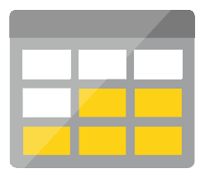




Azure: A Developer’s Perspective
Platform
Event Grid
Logic Apps
Functions
Manage all events that can trigger code or logic
Design workflows and orchestrate processes
Execute your code based on events you specify
Database
Storage
Security
IoT
Analytics
Intelligence

Slide 19
Azure: A Developer’s Perspective
Development
Platform
IDE support
Event Grid
Logic Apps
Functions
</>
Manage all events that can trigger code or logic
Design workflows and orchestrate processes
Execute your code based on events you specify
Integrated DevOps
Local Development
Monitoring
Database
Storage
Security
IoT
Analytics
Intelligence
Visual Debug History

Slide 20
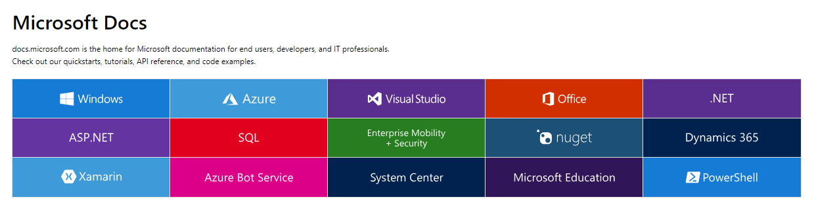
DOCS.COM – Your Starting Point

Slide 21
DOCS.COM – Your Starting Point
All open source on GitHub
You can provide feedback directly from the page
Pull Requests to improve documentation
One of the largest open source projects on GitHub!

Slide 22
Docs.Microsoft.com/Azure
Compute
Networking
Storage
Web
Mobile
Containers
Databases
Analytics
AI/ML
IoT
Integration
Identity
Security
DevOps
Dev Tools
Manager Tools
Media
Migration
Azure Stack
Sovereign Clouds

Slide 23
Lab: Hands-on docs!
Notes:
Challenge: find the documentation to create a serverless function using your language of choice

Slide 24
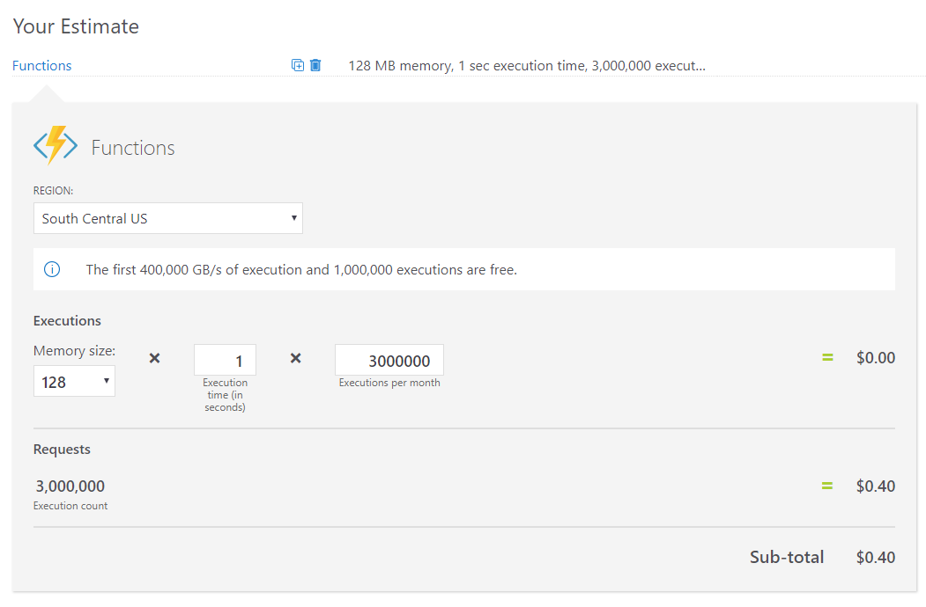
The Azure Pricing Calculator

Slide 25
Lab: Price it!
Notes:
Challenge: estimate the monthly cost for a Windows app service on the shared tier with an Azure SQL Database (single database, DTU model) retaining weekly backups for a month, monthly backups for a year, and yearly backups for 5 years.
Bonus: how much extra is it with transparent data encryption enabled?

Slide 26
Introducing the Azure Portal

Slide 27
Lab: Dashing Groups
Notes:
Challenge: Create a custom dashboard, create a resource group, then pin the resource group to the dashboard

Slide 28
Introducing the Azure Cloud Shell and CLI

Slide 29
Lab: Command and Conquer
Notes:
Challenge: Create a resource group, then create a virtual machine and connect to it all using the command line interface

